Slide 1
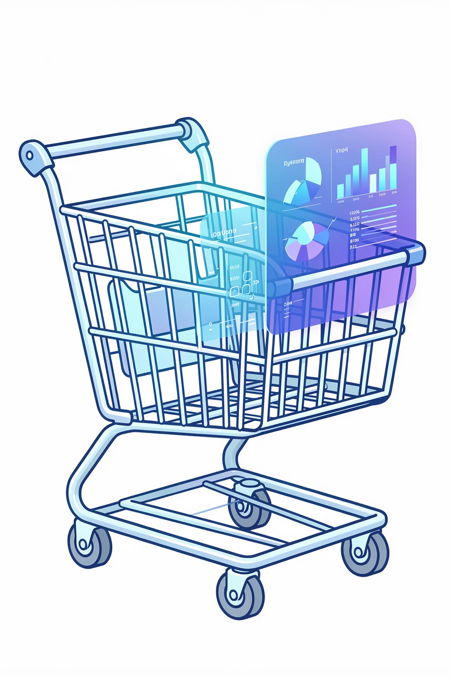
Customer Shopping Behavior Analysis
Uncovering insights from 3,900 purchases to guide strategic business decisions through data-driven analysis of spending patterns, customer segments, and product preferences.

Slide 2
DATASET OVERVIEW
The Foundation: Our Data
3,900
18
37
Total Purchases
Data Columns
Missing Values
Transactions analyzed across all categories
Features spanning demographics to behavior
Only in Review Rating column
Key features include customer demographics (age, gender, location, subscription status), purchase details (item, category, amount, season), and shopping behavior (discounts, previous purchases, review ratings, shipping type).

Slide 3
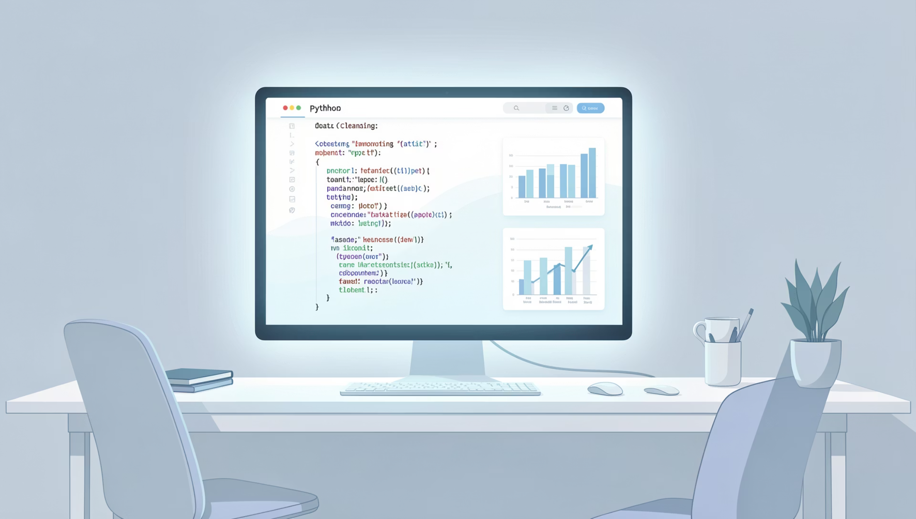
Data Preparation & Engineering
Python-Powered Transformation
We cleaned and enhanced the dataset through systematic preparation:
Imputed missing Review Ratings using category medians
Standardized column names to snake_case
Created age_group bins for segmentation
Engineered purchase_frequency_days feature
Removed redundant promo_code_used column
Integrated with PostgreSQL for SQL analysis

Slide 4
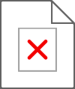
SQL ANALYSIS
Key Business Questions Explored
01
02
03
Revenue by Gender
High-Spending Discount Users
Top-Rated Products
Compared spending patterns between male and female customers
Found customers using discounts while spending above average
Identified the 5 products with highest review ratings
04
05
Shipping Preferences
Subscription Impact
Analyzed purchase amounts by Standard vs. Express shipping
Compared spending between subscribers and non-subscribers

Slide 5
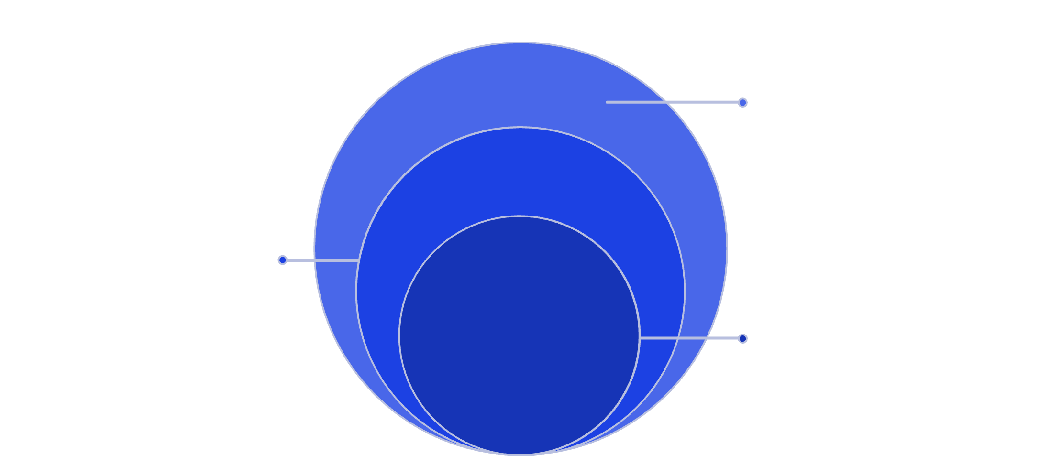
Customer Segmentation Insights
New
Repeat Buyers & Subscriptions
First purchase; onboarding focus
Analysis shows customers with more than 5 purchases demonstrate significantly higher subscription rates, indicating strong correlation between purchase frequency and subscription likelihood.
Returning
2–5 purchases; repeat buyers
Loyal
5+ purchases; highest subscription rate
This insight validates the importance of converting repeat buyers into loyal subscribers.
Classification based on purchase history reveals distinct customer lifecycle stages.

Slide 6

Revenue by Age Group
Age segmentation reveals distinct spending patterns across demographic groups, with certain age brackets contributing disproportionately to total revenue.
Young Adults
Mid-Career
Established
18-30 years: Moderate spending, high digital engagement
31-45 years: Highest revenue contribution, premium preferences
46-60 years: Consistent spending, loyalty-driven
Seniors
60+ years: Quality-focused, lower frequency

Slide 7
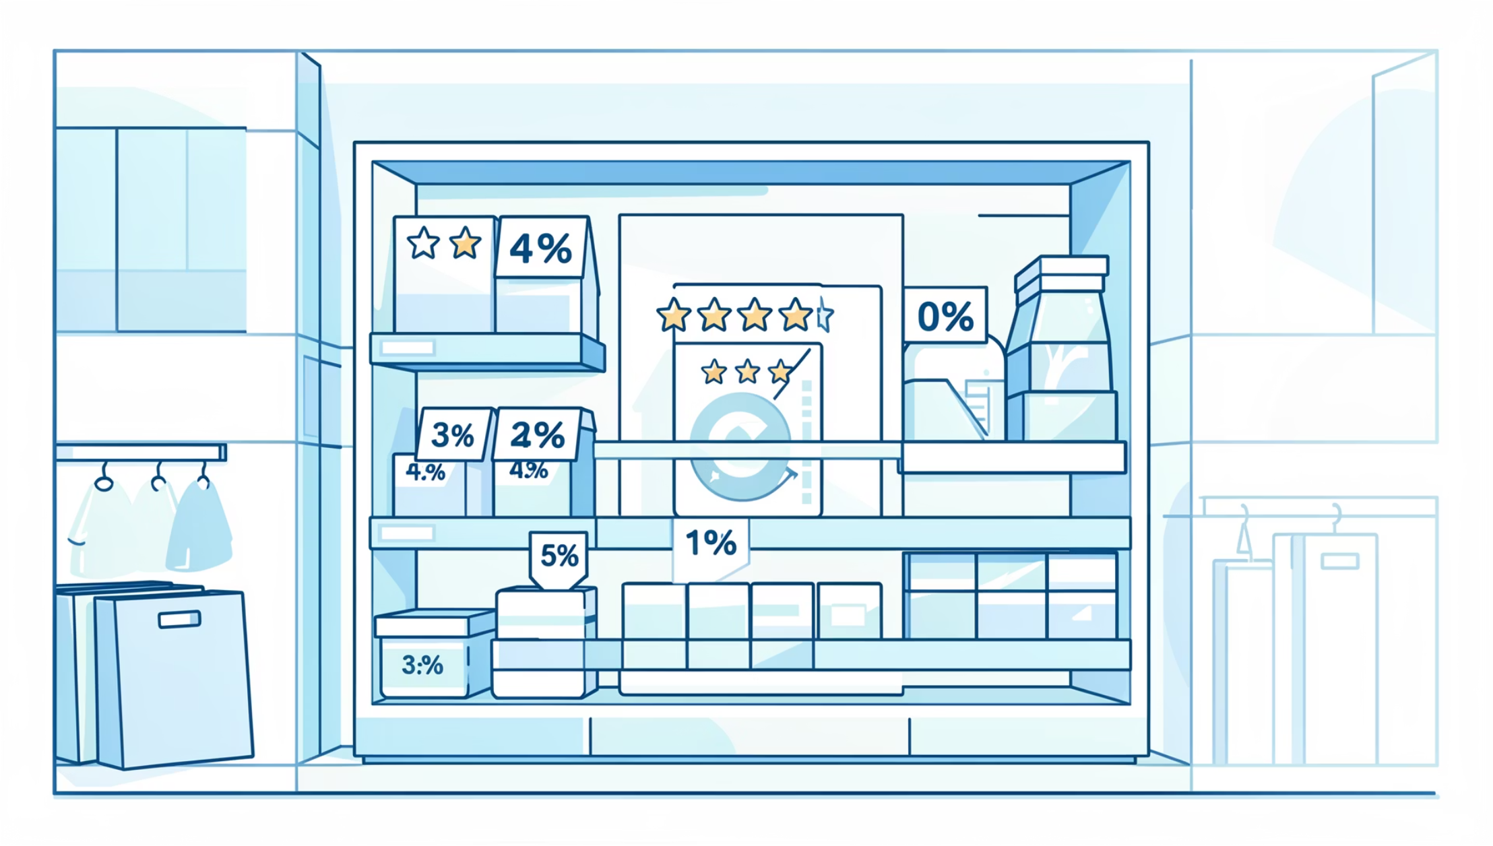
Product Performance Analysis
Top-Rated Products
Five products achieved exceptional average review ratings, indicating superior customer satisfaction and quality perception.
These high-performers span multiple categories, suggesting quality excellence across the product portfolio.
Discount-Dependent Products
Five products showed the highest percentage of discounted purchases, revealing price-sensitive items that may require strategic pricing adjustments.

Slide 8


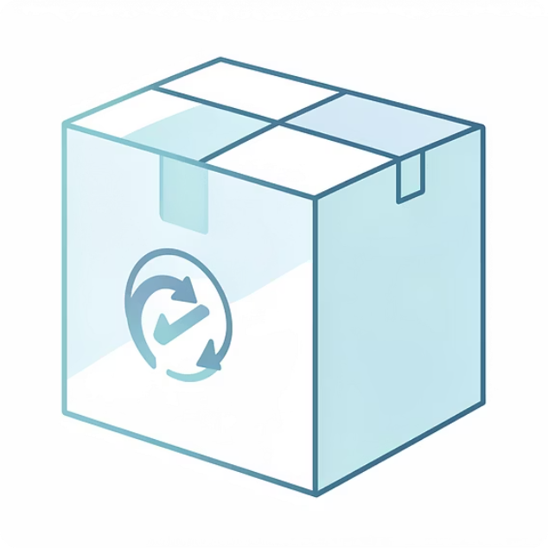
Shipping & Subscription Patterns
Express Shipping
Standard Shipping
Subscriber Advantage
Higher average purchase amounts indicate premium customer segment willing to pay for speed.
Lower average spend but higher volume, representing cost-conscious majority.
Subscribers show higher average spend and generate significantly more total revenue than non-subscribers.

Slide 9
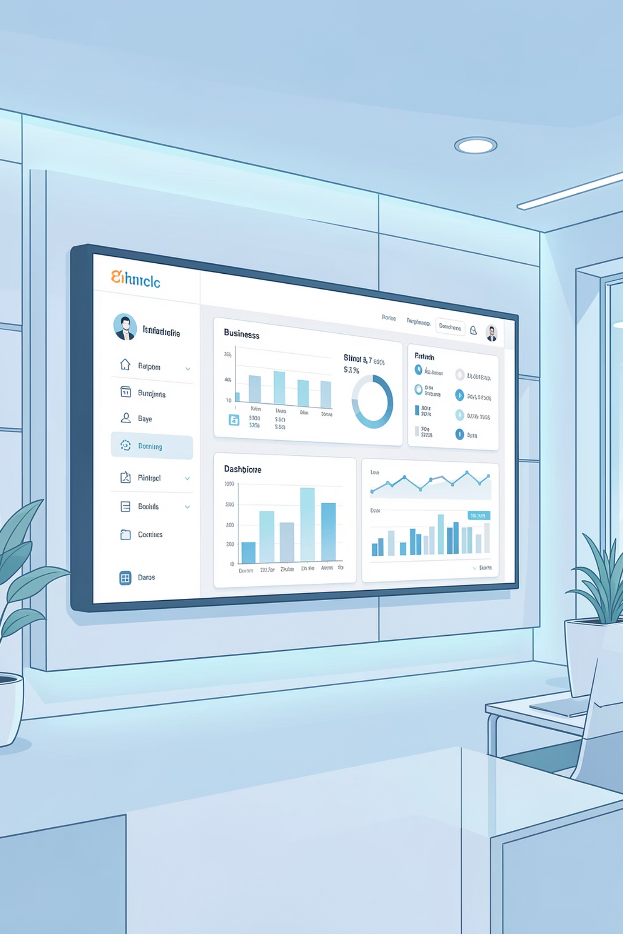
Power BI Dashboard
An interactive dashboard brings all insights together, enabling real-time exploration of customer behavior patterns, revenue trends, and product performance across multiple dimensions.
Visual Analytics
Drill-Down Capability
Real-Time Updates
Dynamic charts and graphs for instant insight discovery
Explore data at granular levels across all dimensions
Live data integration for current business intelligence

Slide 10
STRATEGIC RECOMMENDATIONS
Actionable Business Strategies
Boost Subscriptions
Loyalty Programs
Review Discount Policy
Promote exclusive benefits and perks to convert repeat buyers into loyal subscribers.
Reward repeat buyers to accelerate their journey into the "Loyal" customer segment.
Balance promotional sales boosts with margin control for sustainable growth.
Product Positioning
Targeted Marketing
Highlight top-rated and best-selling products in marketing campaigns.
Focus efforts on high-revenue age groups and express-shipping users for maximum ROI.

